Slide 1
Brand Strategy Outcome

Slide 2
Problem Statement
To classify whether a tweet belongs to the following sentiment
0 – Negative
1 – Neutral
2 – Positive
3 – Can’t Tell

Slide 3
Why Solve this problem
Manual assessment of tweet classification is time consuming
Automatic Sentiment Analysis delivers a lot of value
Helps in taking a stand towards product manufacturing, inventory and sales.

Slide 4
Data
Dataset Information
The train data consists of 7274 records and 3 columns(Tweet id, Tweet, Sentiment - label)
The test data consists of 1819 records and 2 columns (Tweet id and Tweet)
Train Data
Test Data
Column | Type | Description
Tweet_id | Int64 | Unique id
Tweet | Object | Text of the tweet
Sentiment – Target/Label | Int64 | Can take following 4 values: 0 – negative 1 – neutral 2 – positive 3 – Cant Tell
Column | Type | Description
Tweet_id | Int64 | Unique id
Tweet | Object | Text of the tweet

Slide 5
EDA
Data Cleaning
Removal of @user handles
Removal of lxml codes (using Beautiful Soup)
Removal of special characters, punctuations, numbers (using regular expressions)
Data Visualisation
Pie Chart for Sentiment Counts
Bar Chart for visualising Hashtag Trends and its significance
Word Cloud – Word frequency importance
Box plot to check the length of the tweet text.

Slide 6
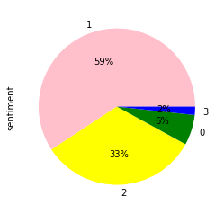
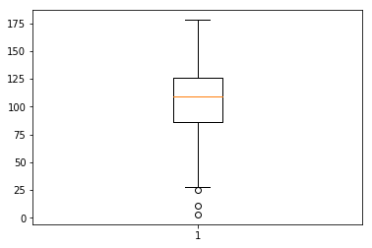
Visualisation Figures

Slide 7
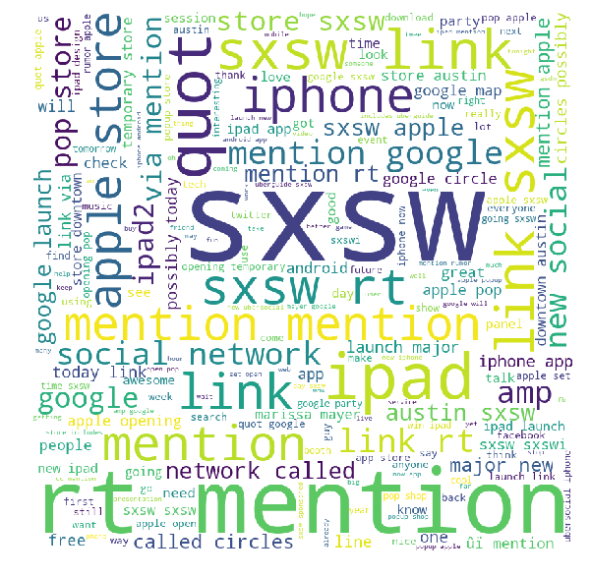
Visualisation Figures - Word Cloud

Slide 8
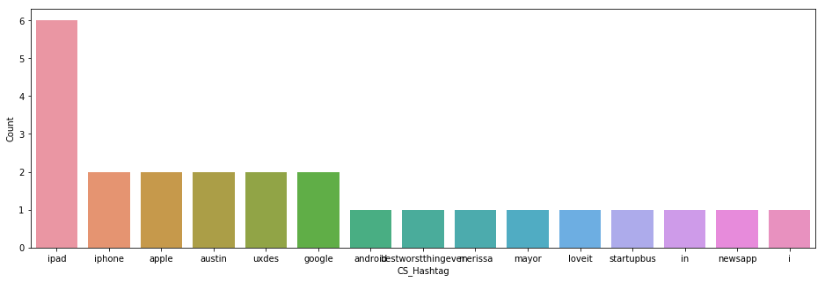
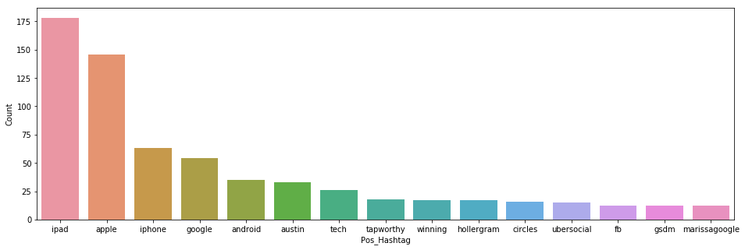
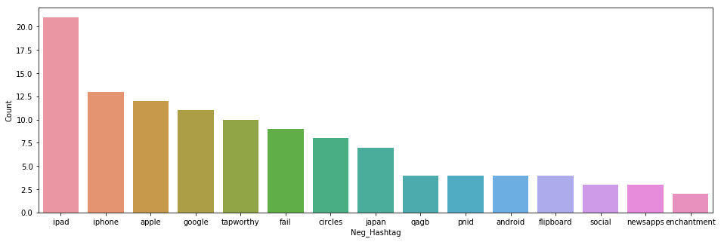
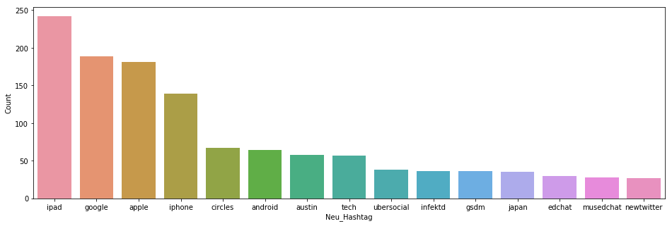
Visualisation Figures

Slide 9
Evaluation Metric
F1 Score
Model | F1 – Score (with Lemmatisation) | F1 – Score (with Stemming)
Logistic Regression | 0.6099 | 0.6180
Naïve Bayes | 0.4576 | -
Linear SVC | 0.6626 | 0.6652
Random Forest Classifier | 0.5790 | 0.615
Decision Tree | - | 0.5844
Gradient Boosting | - | 0.6350
XG Boost | 0.6283 | -
ADA Boost | 0.5375 | -
Voting Classifier | 0.6179 | 0.6062

Slide 10
Business Insights
Product Marketing should be done at events similar to SXSW
Since the test data results gives highest measure to neutral stance(using Linear SVC model), the product company should carry on its activities as it use to carry out previously.

